Slide 1
Lab 1
Elastic Cloud Setup
Notes:
Allow us to introduce Elastic SIEM — our first official step in building our vision for what a SIEM should be.

Slide 2
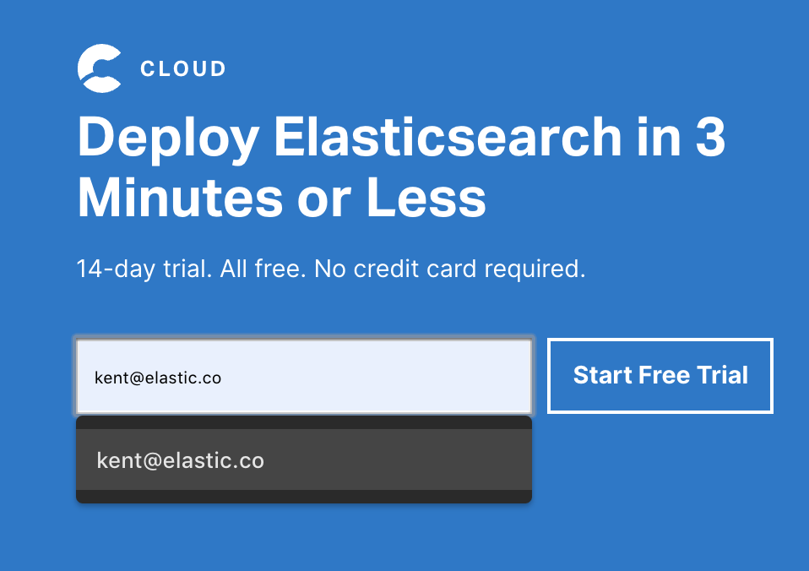
Sign up for the Elastic Cloud Trial
Go to https://cloud.elastic.co
1
Enter your business email (no credit card is required)
2
Select ‘Start Free Trial’

Slide 3
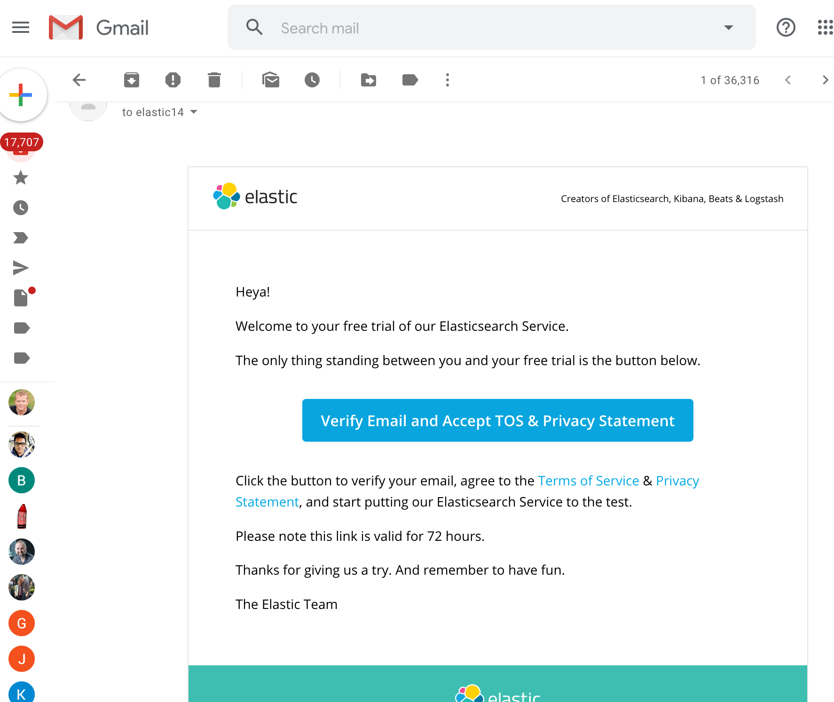
Cloud Account Validation
Verify Email
1
Find message with the Subject: ‘[Action Required] It Worked! Your Elasticsearch Service Trial Awaits.’
2
Select the ‘Verify Email…’ link

Slide 4
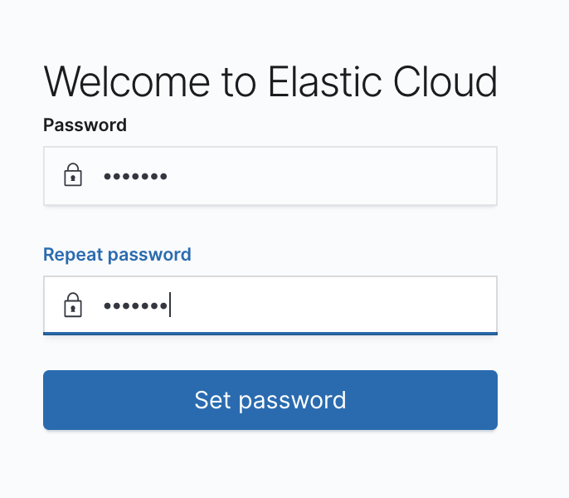
Set Password
After the password is set, you will automatically be logged in
1
Create a strong password
2
Repeat strong password

Slide 5
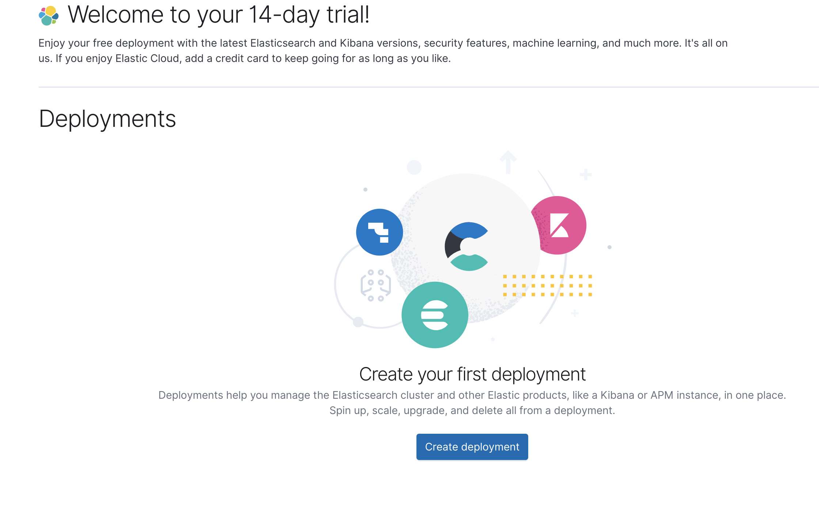
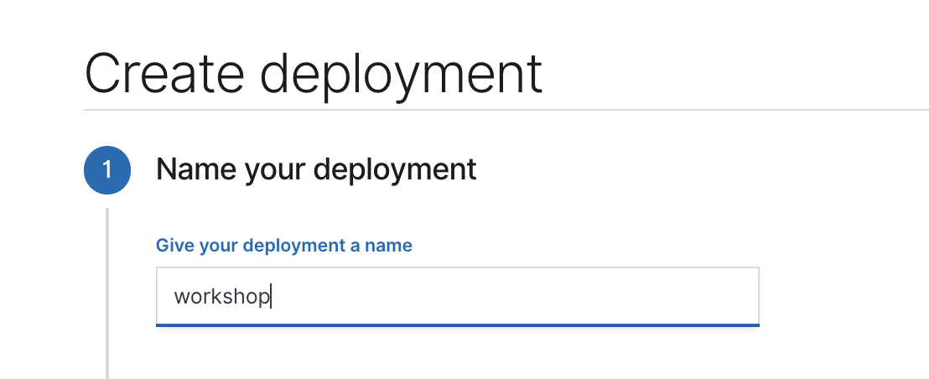
Create Your Elastic Cloud Deployment
Name Your Deployment
1
Select ‘Create deployment’
2
Name your deployment (e.g, ‘workshop’)

Slide 6
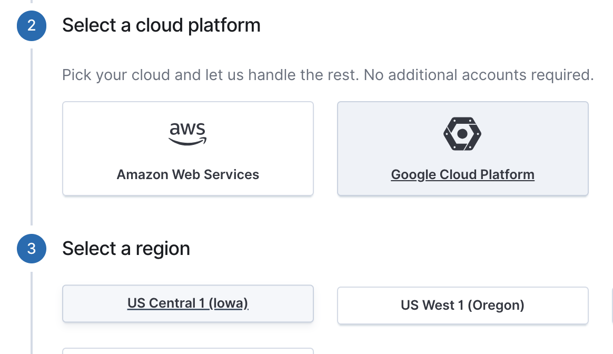
Deployment Options
Choose a Cloud Platform and a Region
1
Select Infrastructure Provider
2
Select region

Slide 7
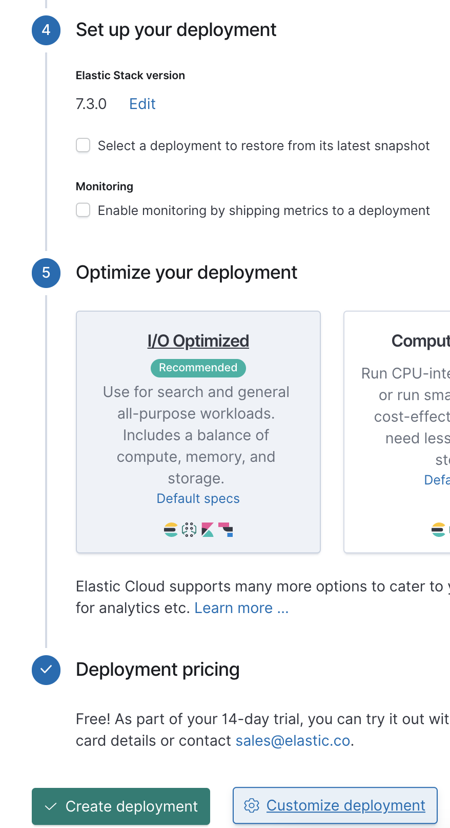
Deployment options
Set Stack Version and Deployment Template
1
The version of the Elastic Stack to be deployed
2
Select ‘I/O Optimized’
3
Select ‘Customize Deployment’

Slide 8
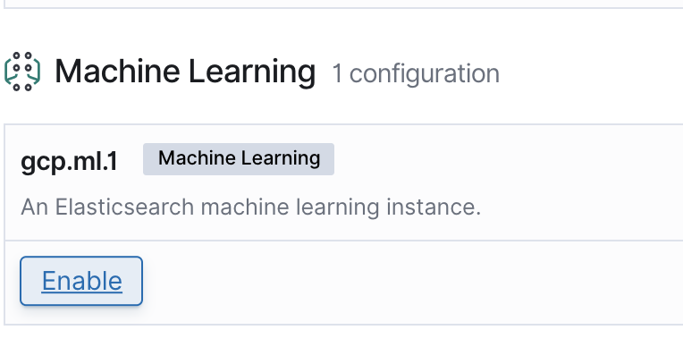
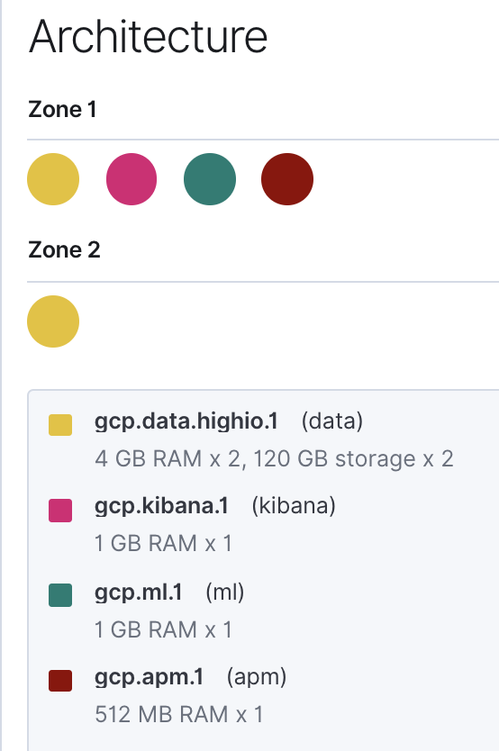
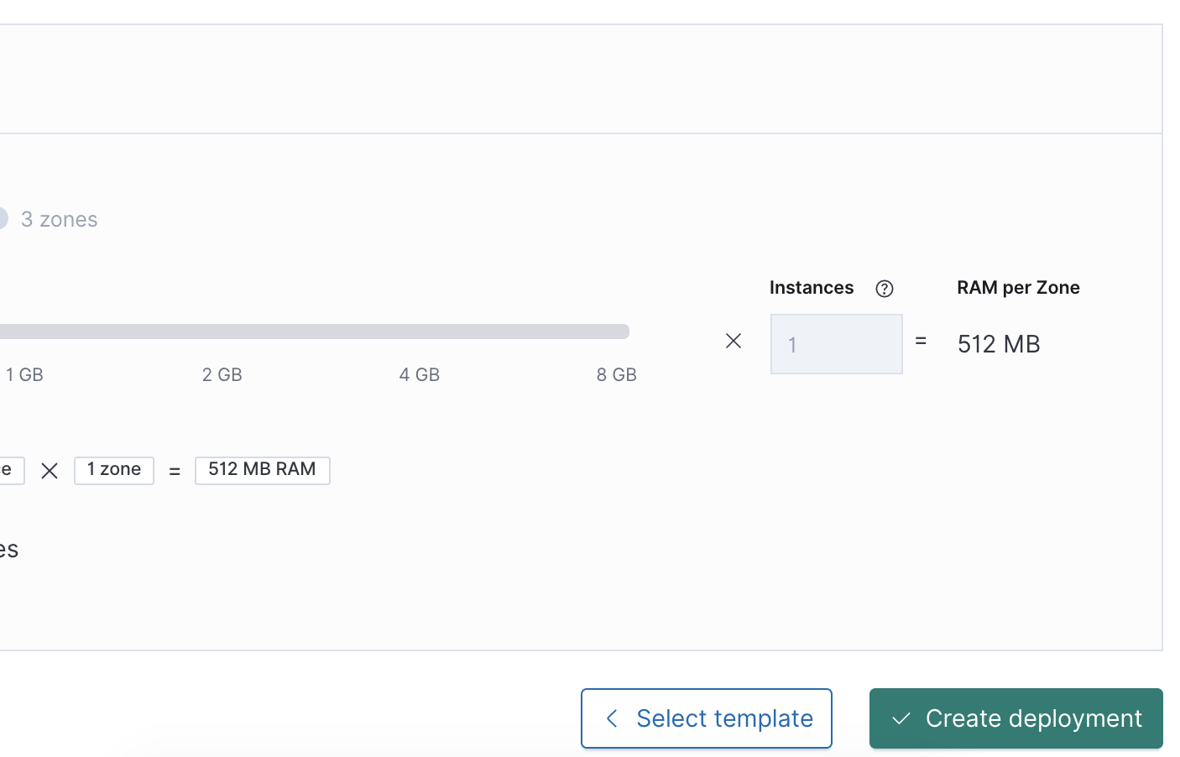
Customize Deployment
Enable Machine Learning
1
Select ‘Enable’ in the Machine Learning configuration
2
Review ‘Architecture summary’
3
Select ‘Create deployment’

Slide 9
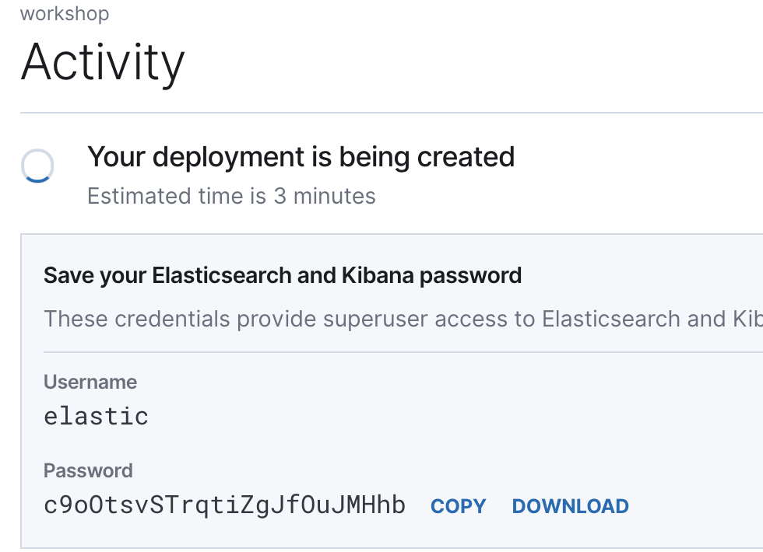
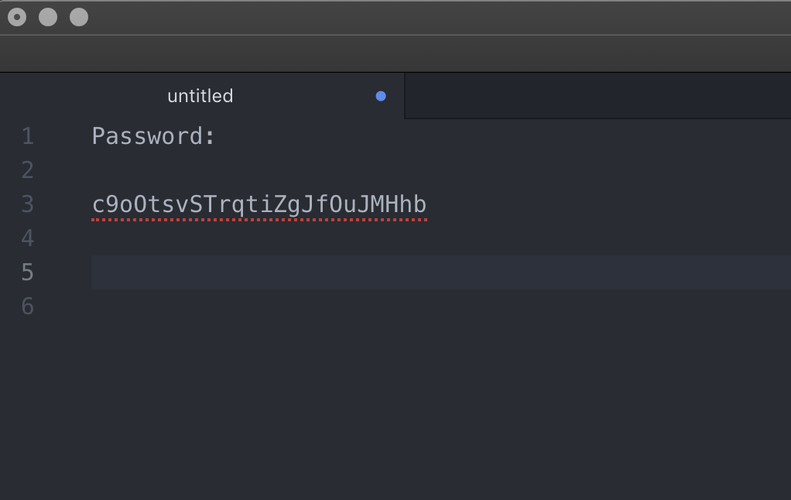
Cluster Password
Save the password
1
Copy the generated password
2
Paste the password in a local text editor

Slide 10
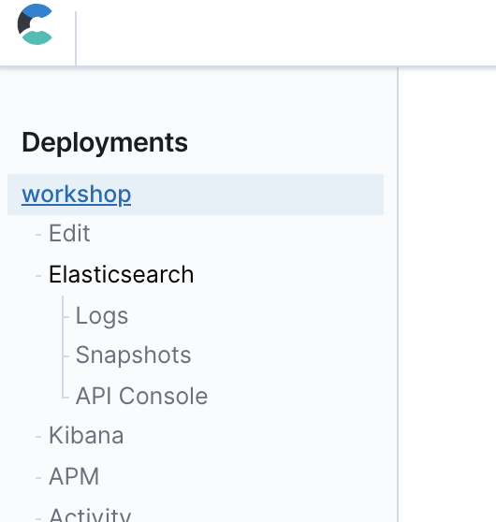
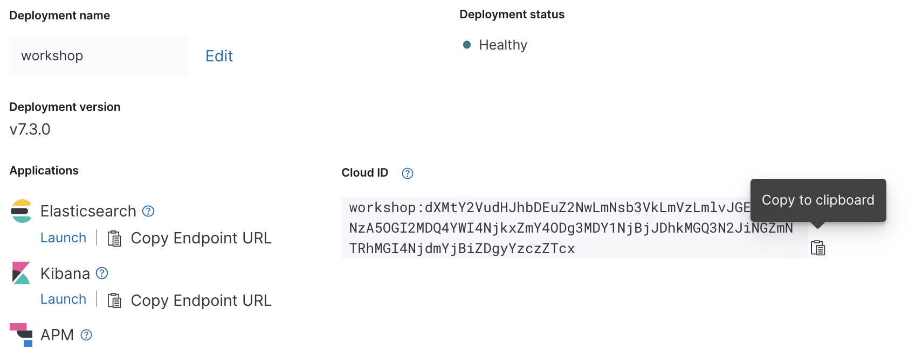
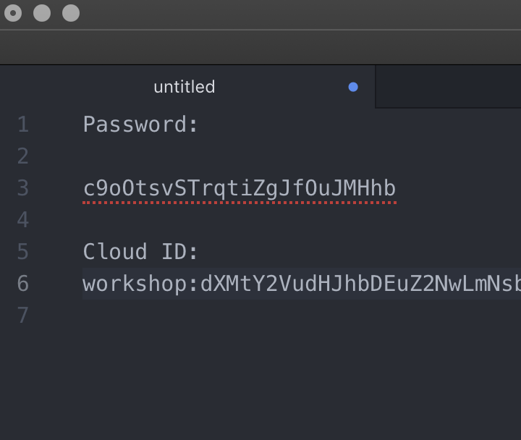
Cloud ID
Save the Cloud ID
1
Select your newly-created deployment under deployments in the left navigation menu
2
Copy the Cloud ID to the clipboard
3
Paste the Cloud ID into a local text editor

Slide 11
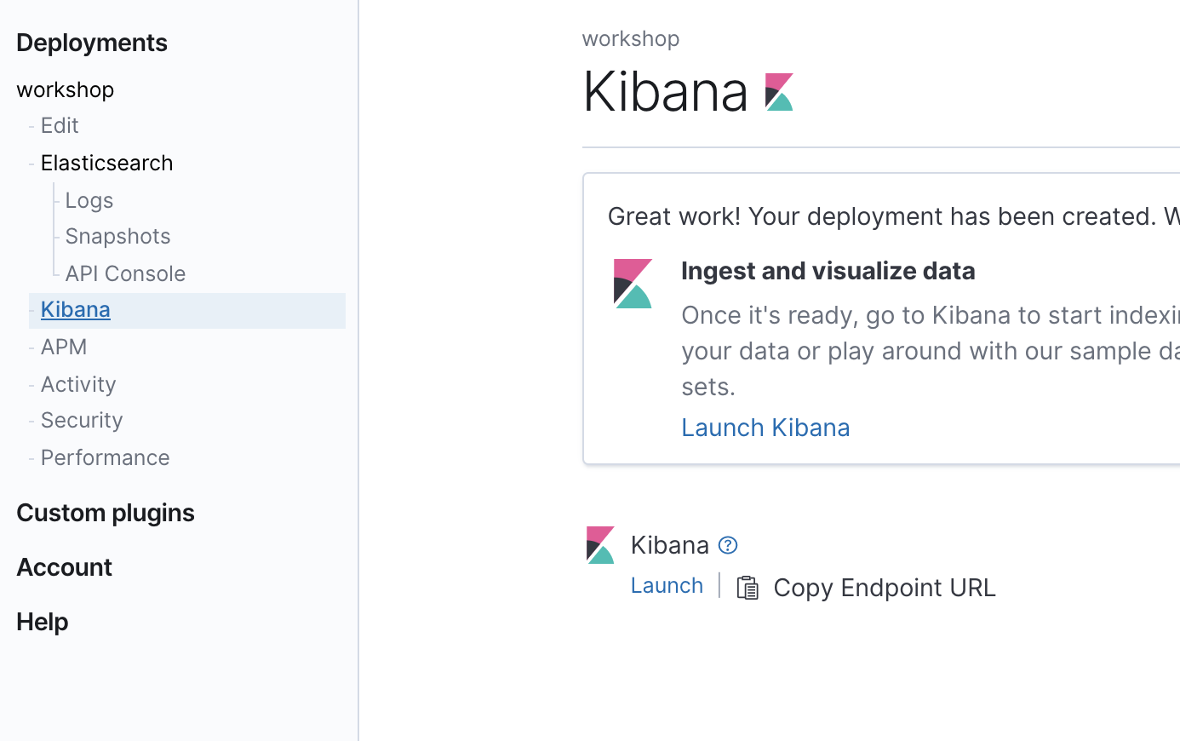
Launch Kibana
Setup complete, Time to launch Kibana
1
Select ‘Kibana’ from left navigation menu
2
Select ‘Launch Kibana’

Slide 12
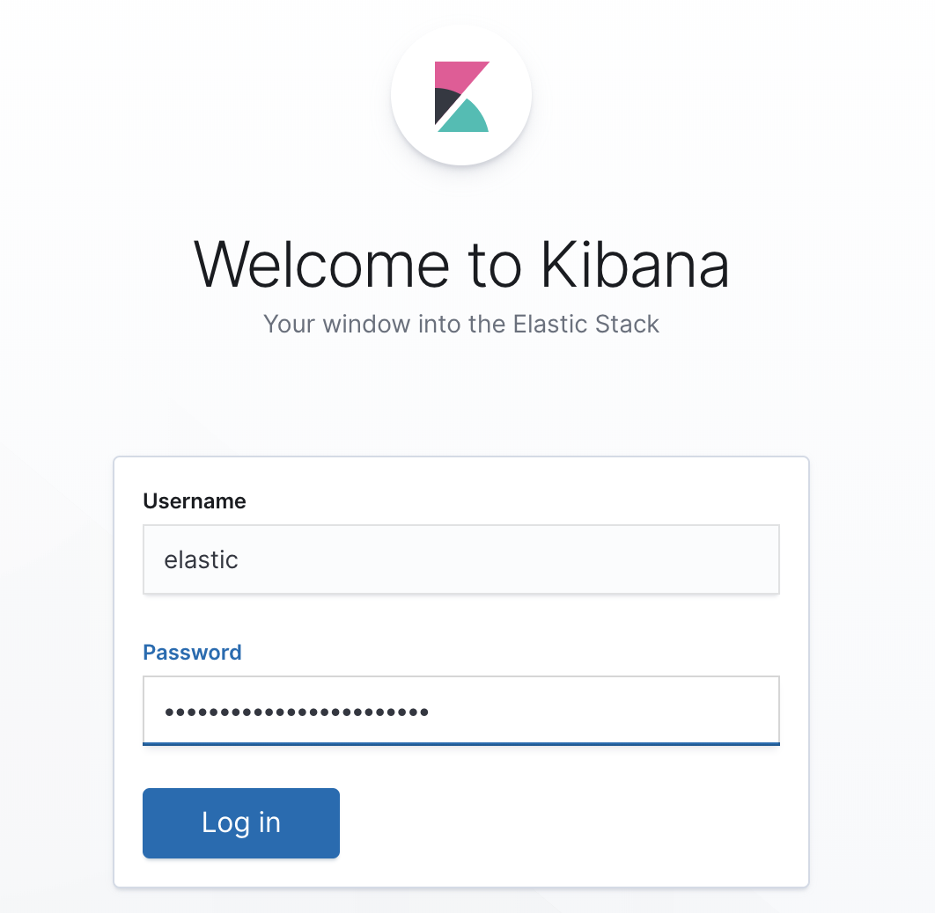
Log into Kibana
As user ‘elastic’
1
Username is: elastic
2
Copy-n-Paste the Cloud elastic user password saved in Lab #1.

Slide 13
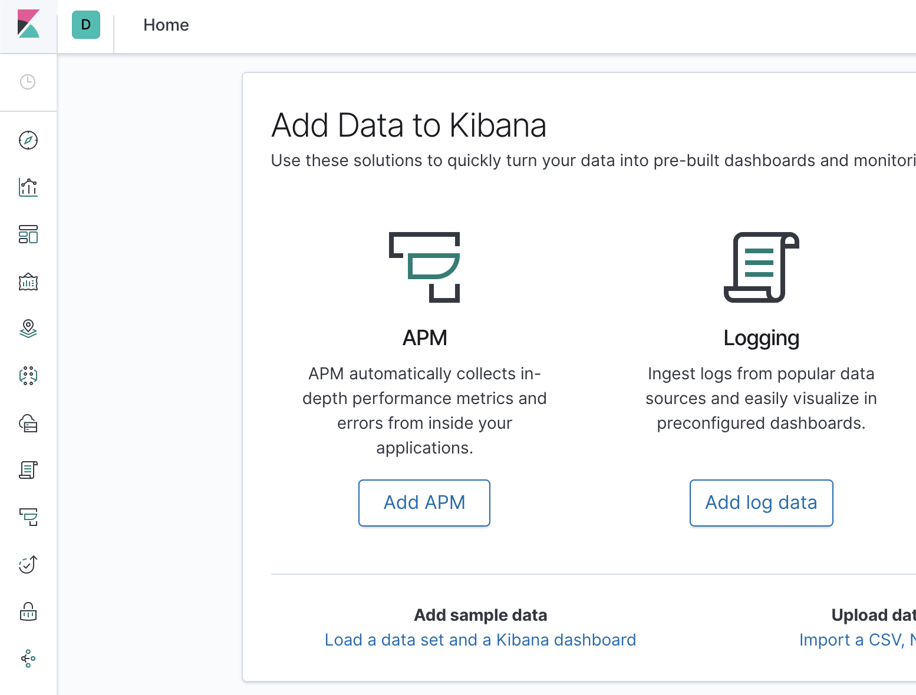
Load Sample Data in Kibana
Kibana load data page
1
Select the ‘K’ icon.
2
Select ‘Load a data..’ link under ‘Add sample data’.

Slide 14
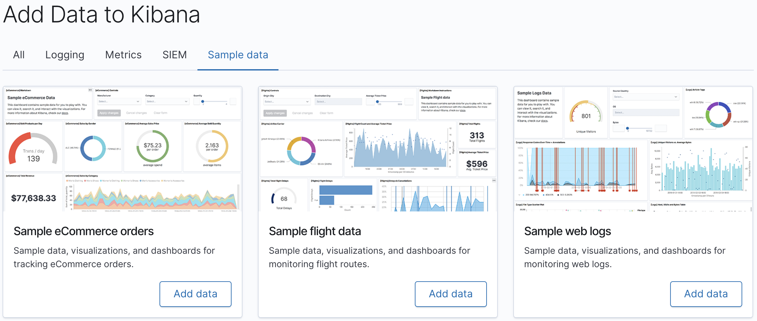
Loading sample data into the Elastic Stack
Load all three data sets - and explore!
1
Add Sample eCommerce orders
2
Add Sample flight data
3
Add Sample web logs

Slide 15
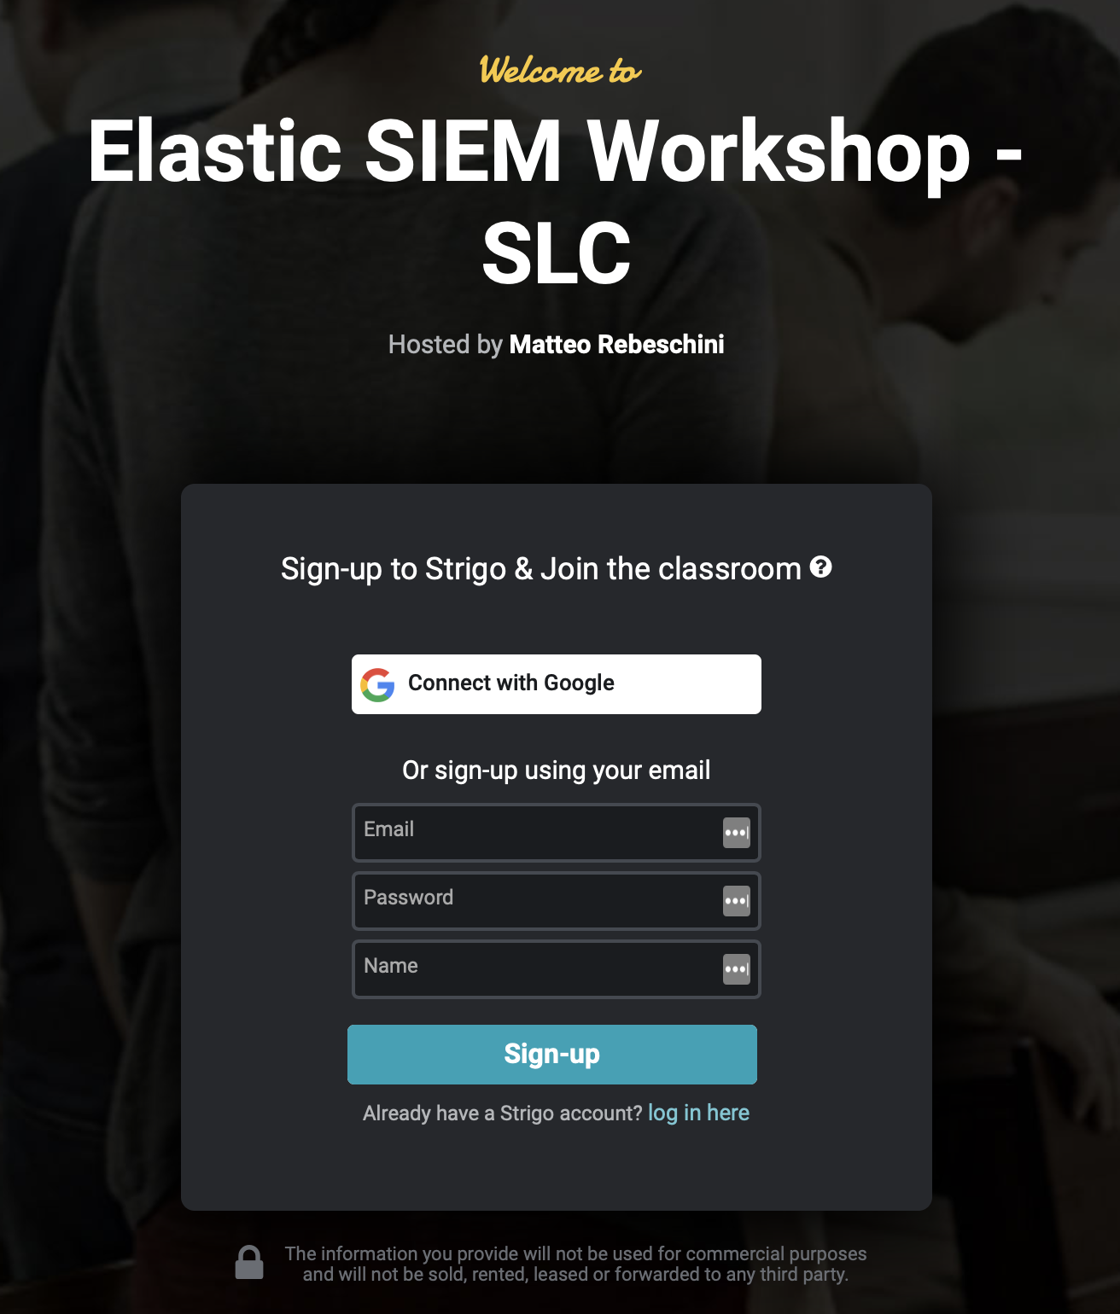
Setup Strigo
Your Training Environment
Class URL:
https://ela.st/bgl-security-lab2
Access Token:
LZPX
Lab environment will stay active until 8/20 @ 6:00PM MDT
Notes:
URL
https://app.strigo.io/event/5BW9NXdrTCR6nzvdB
Access Token
DNXR

Slide 16
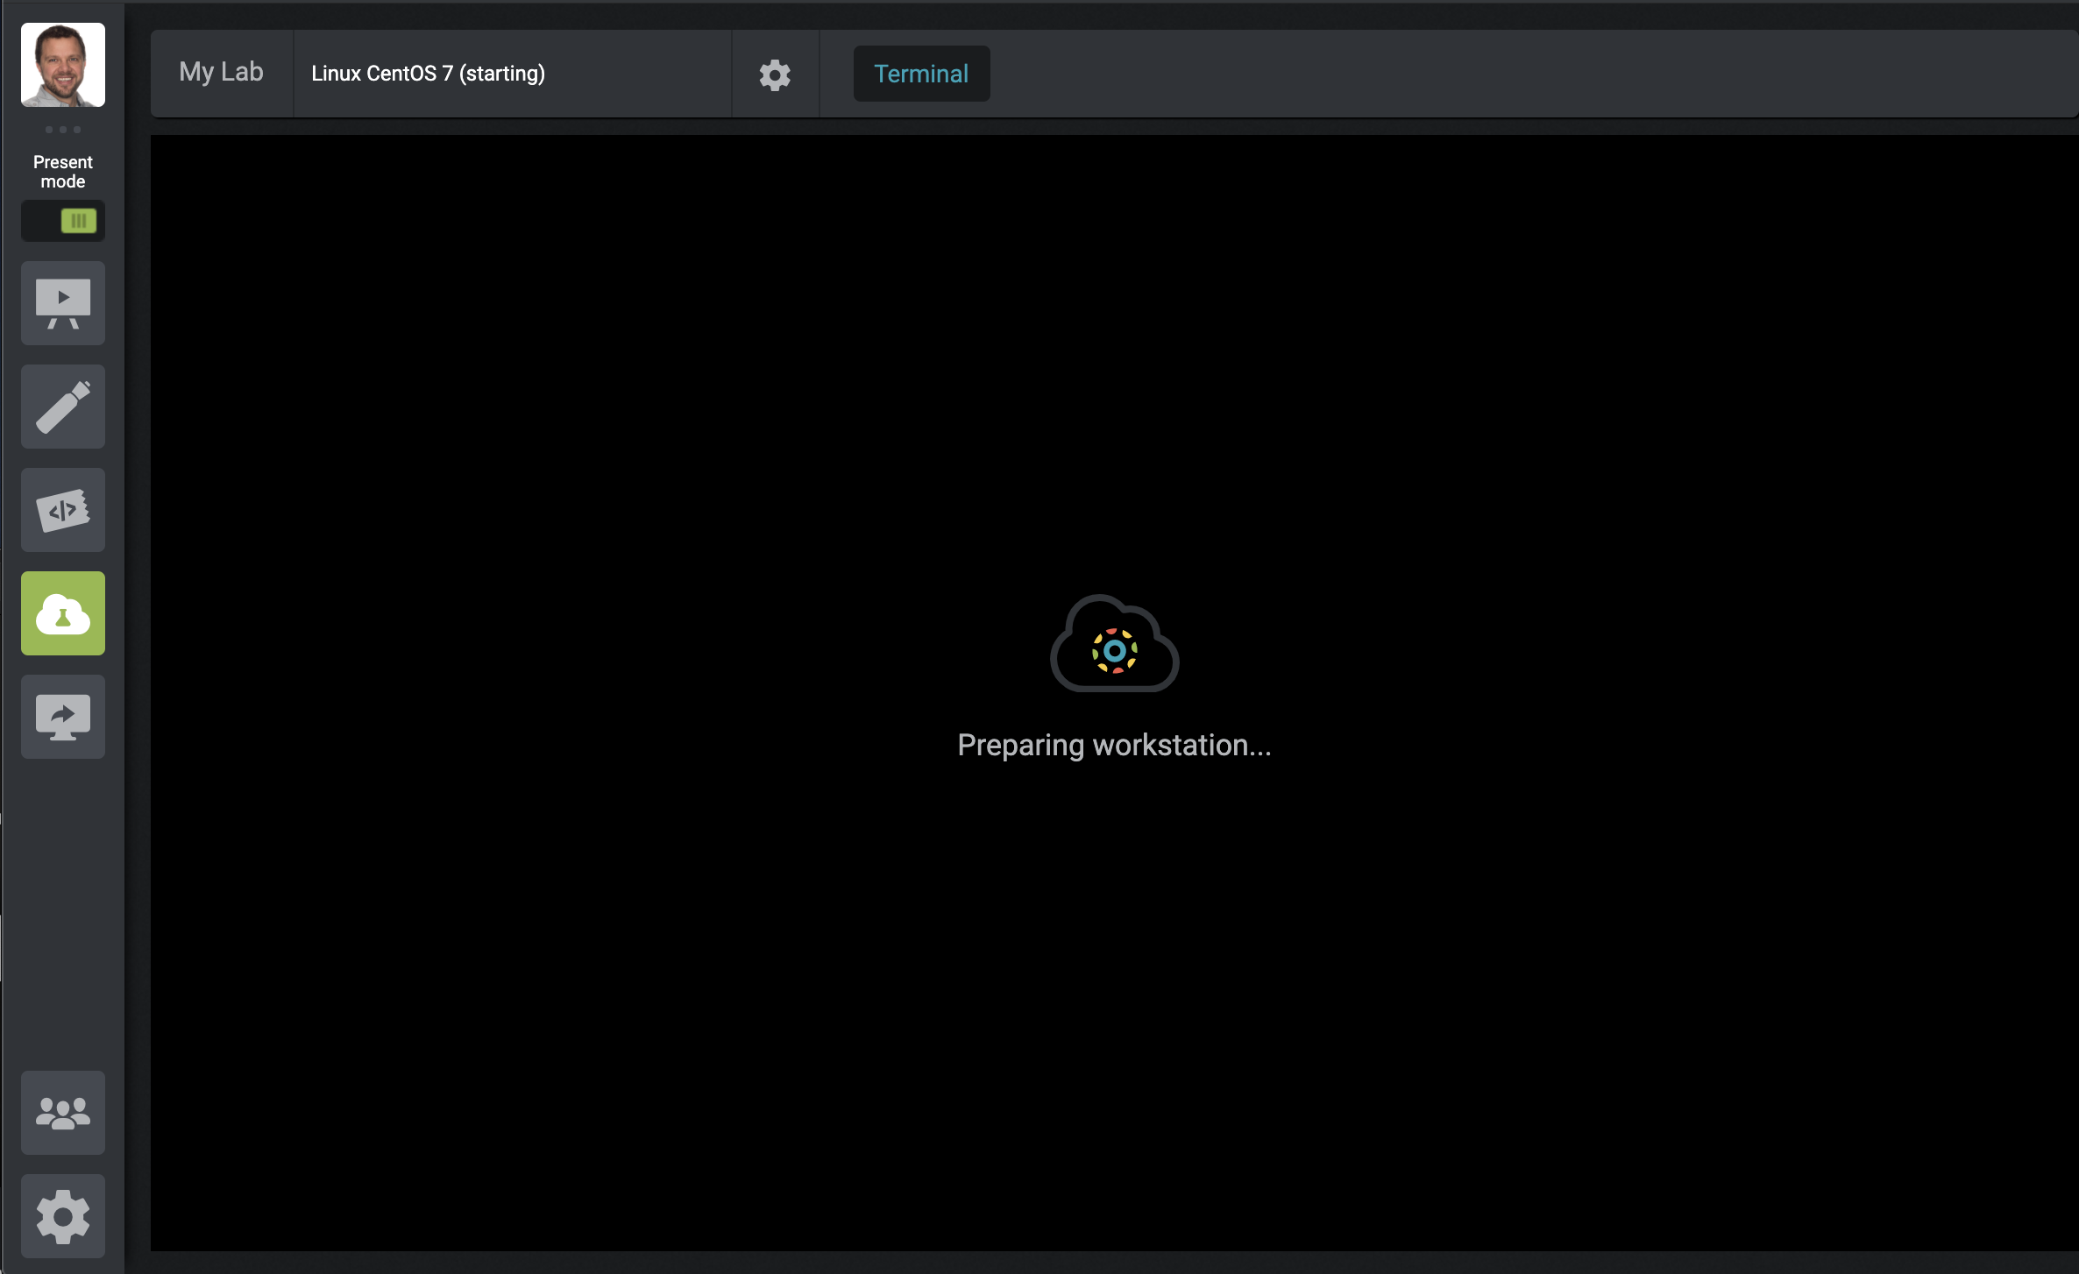
Linux Beats Scripted Install
Access “My Lab” (it will take a few minutes)
1
Select ‘My Lab’

